Slide 1


Introduction to Statistical Machine Learning
Mirgahney H. Mohamed

Slide 2
The goals of AI is to create a machine which can mimic a human mind and to do that it needs learning capabilities, but also more; knowledge representation , logical reasoning and event thighs like abstract thinking.
Machine learning on the other hand focus on writing software or algorithms that can learn from past experience.

Slide 3
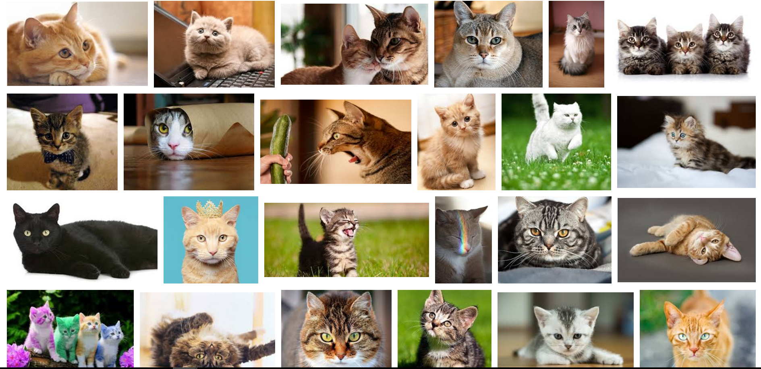

Arthur Samuel (1959). Machine Learning: Field of study that gives computers the ability to learn without being explicitly programmed.
Notes:
Carnegie Mellon University

Slide 4
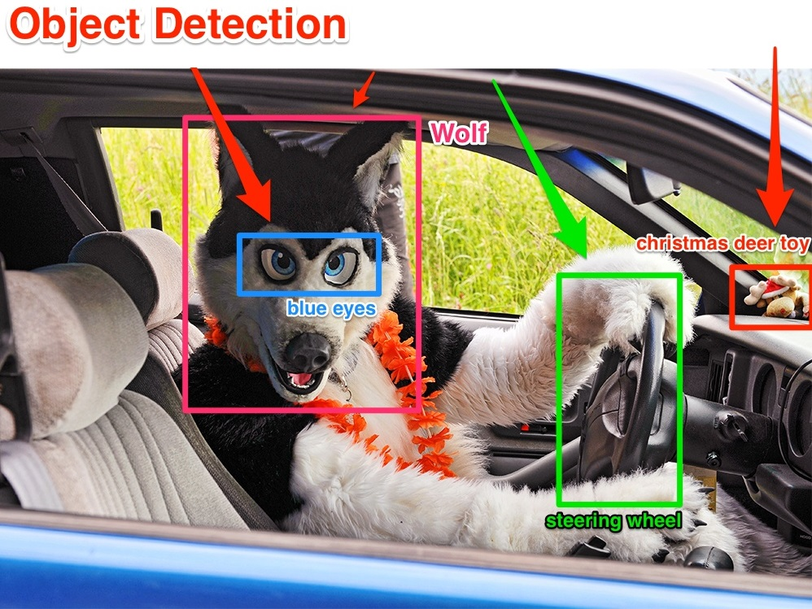


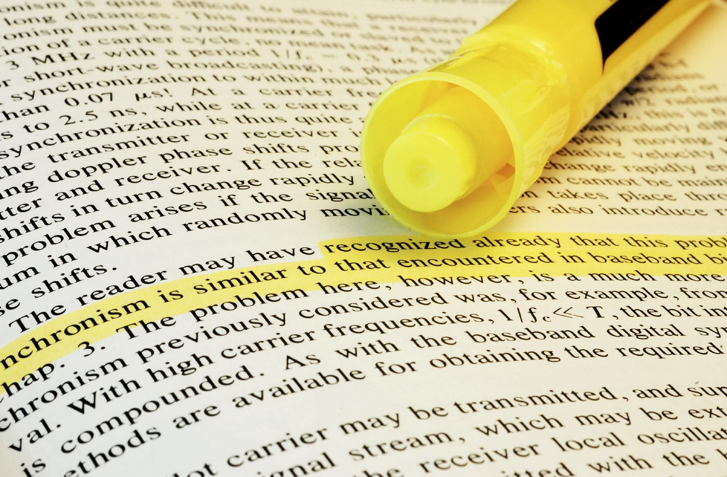
Applications of machine learning
Database mining
Text analysis
Speech Recognition

Slide 5
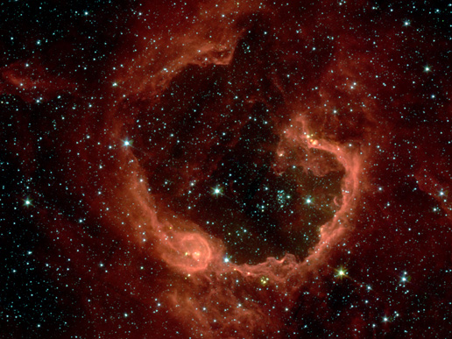



Image credit: NASA/JPL-Caltech/E. Churchwell (Univ. of Wisconsin, Madison)
Astronomical data analysis
Social network analysis
Market segmentation
Genome classification

Slide 6

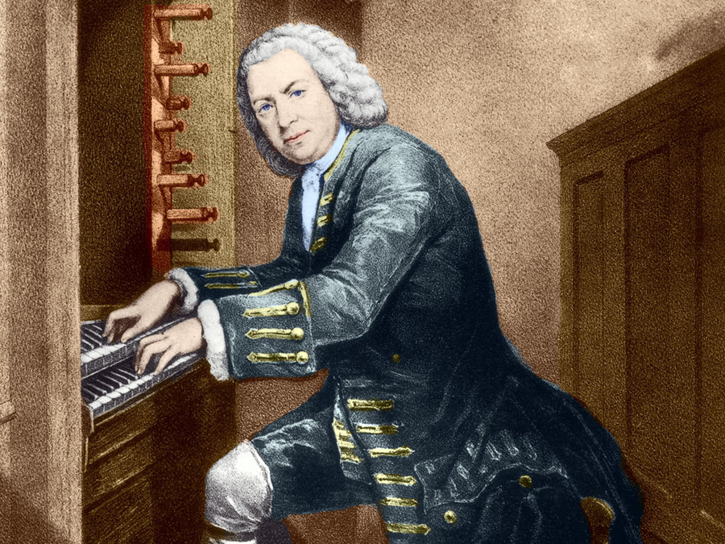
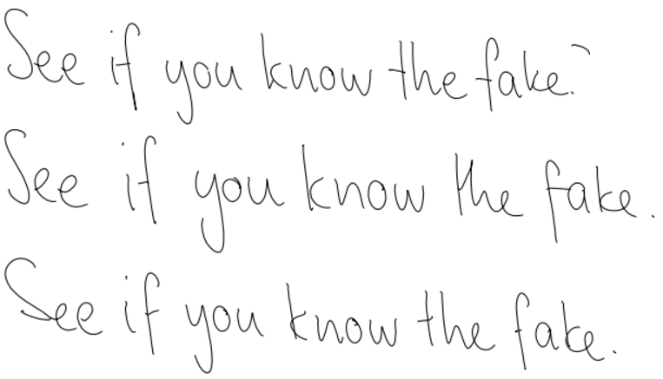



Drawing art with Deep convolutional neural networks.
Mimicking Bach.
Improving writing skill with LSTM.
Make our cars drive itself
Playing Mario with deep reinforcement learning.

Slide 7

Playing Mario

Slide 8

Machine learning algorithms
Supervised learning
Unsupervised learning
Reinforcement learning
Deep learning

Slide 9
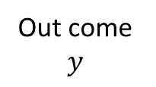
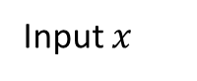
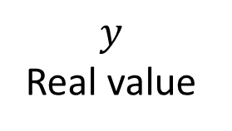
Supervised learning
Supervised learning is the machine learning task of inferring a function from labelled training data.
Predicting exam results
$$y$$
Real value
Out come $y$
exam results
hours
Input $x$

Slide 10
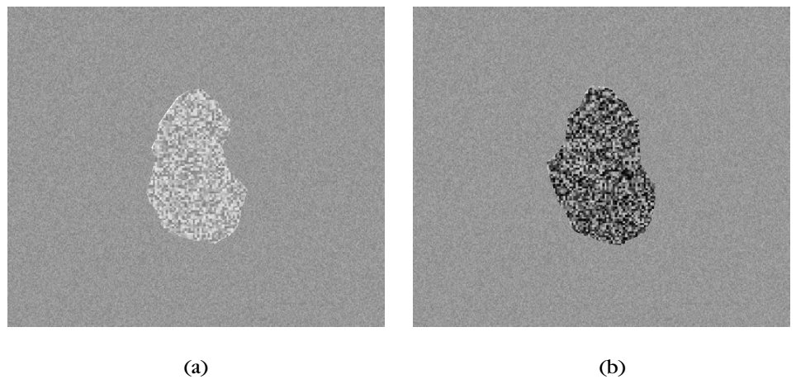
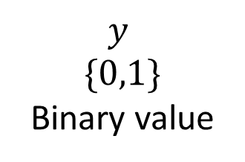
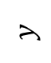
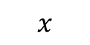
Class a
$$y$$
$$\{0,1\}$$
Binary value
$$y$$
Class b
$$x$$
size
thickness

Slide 11
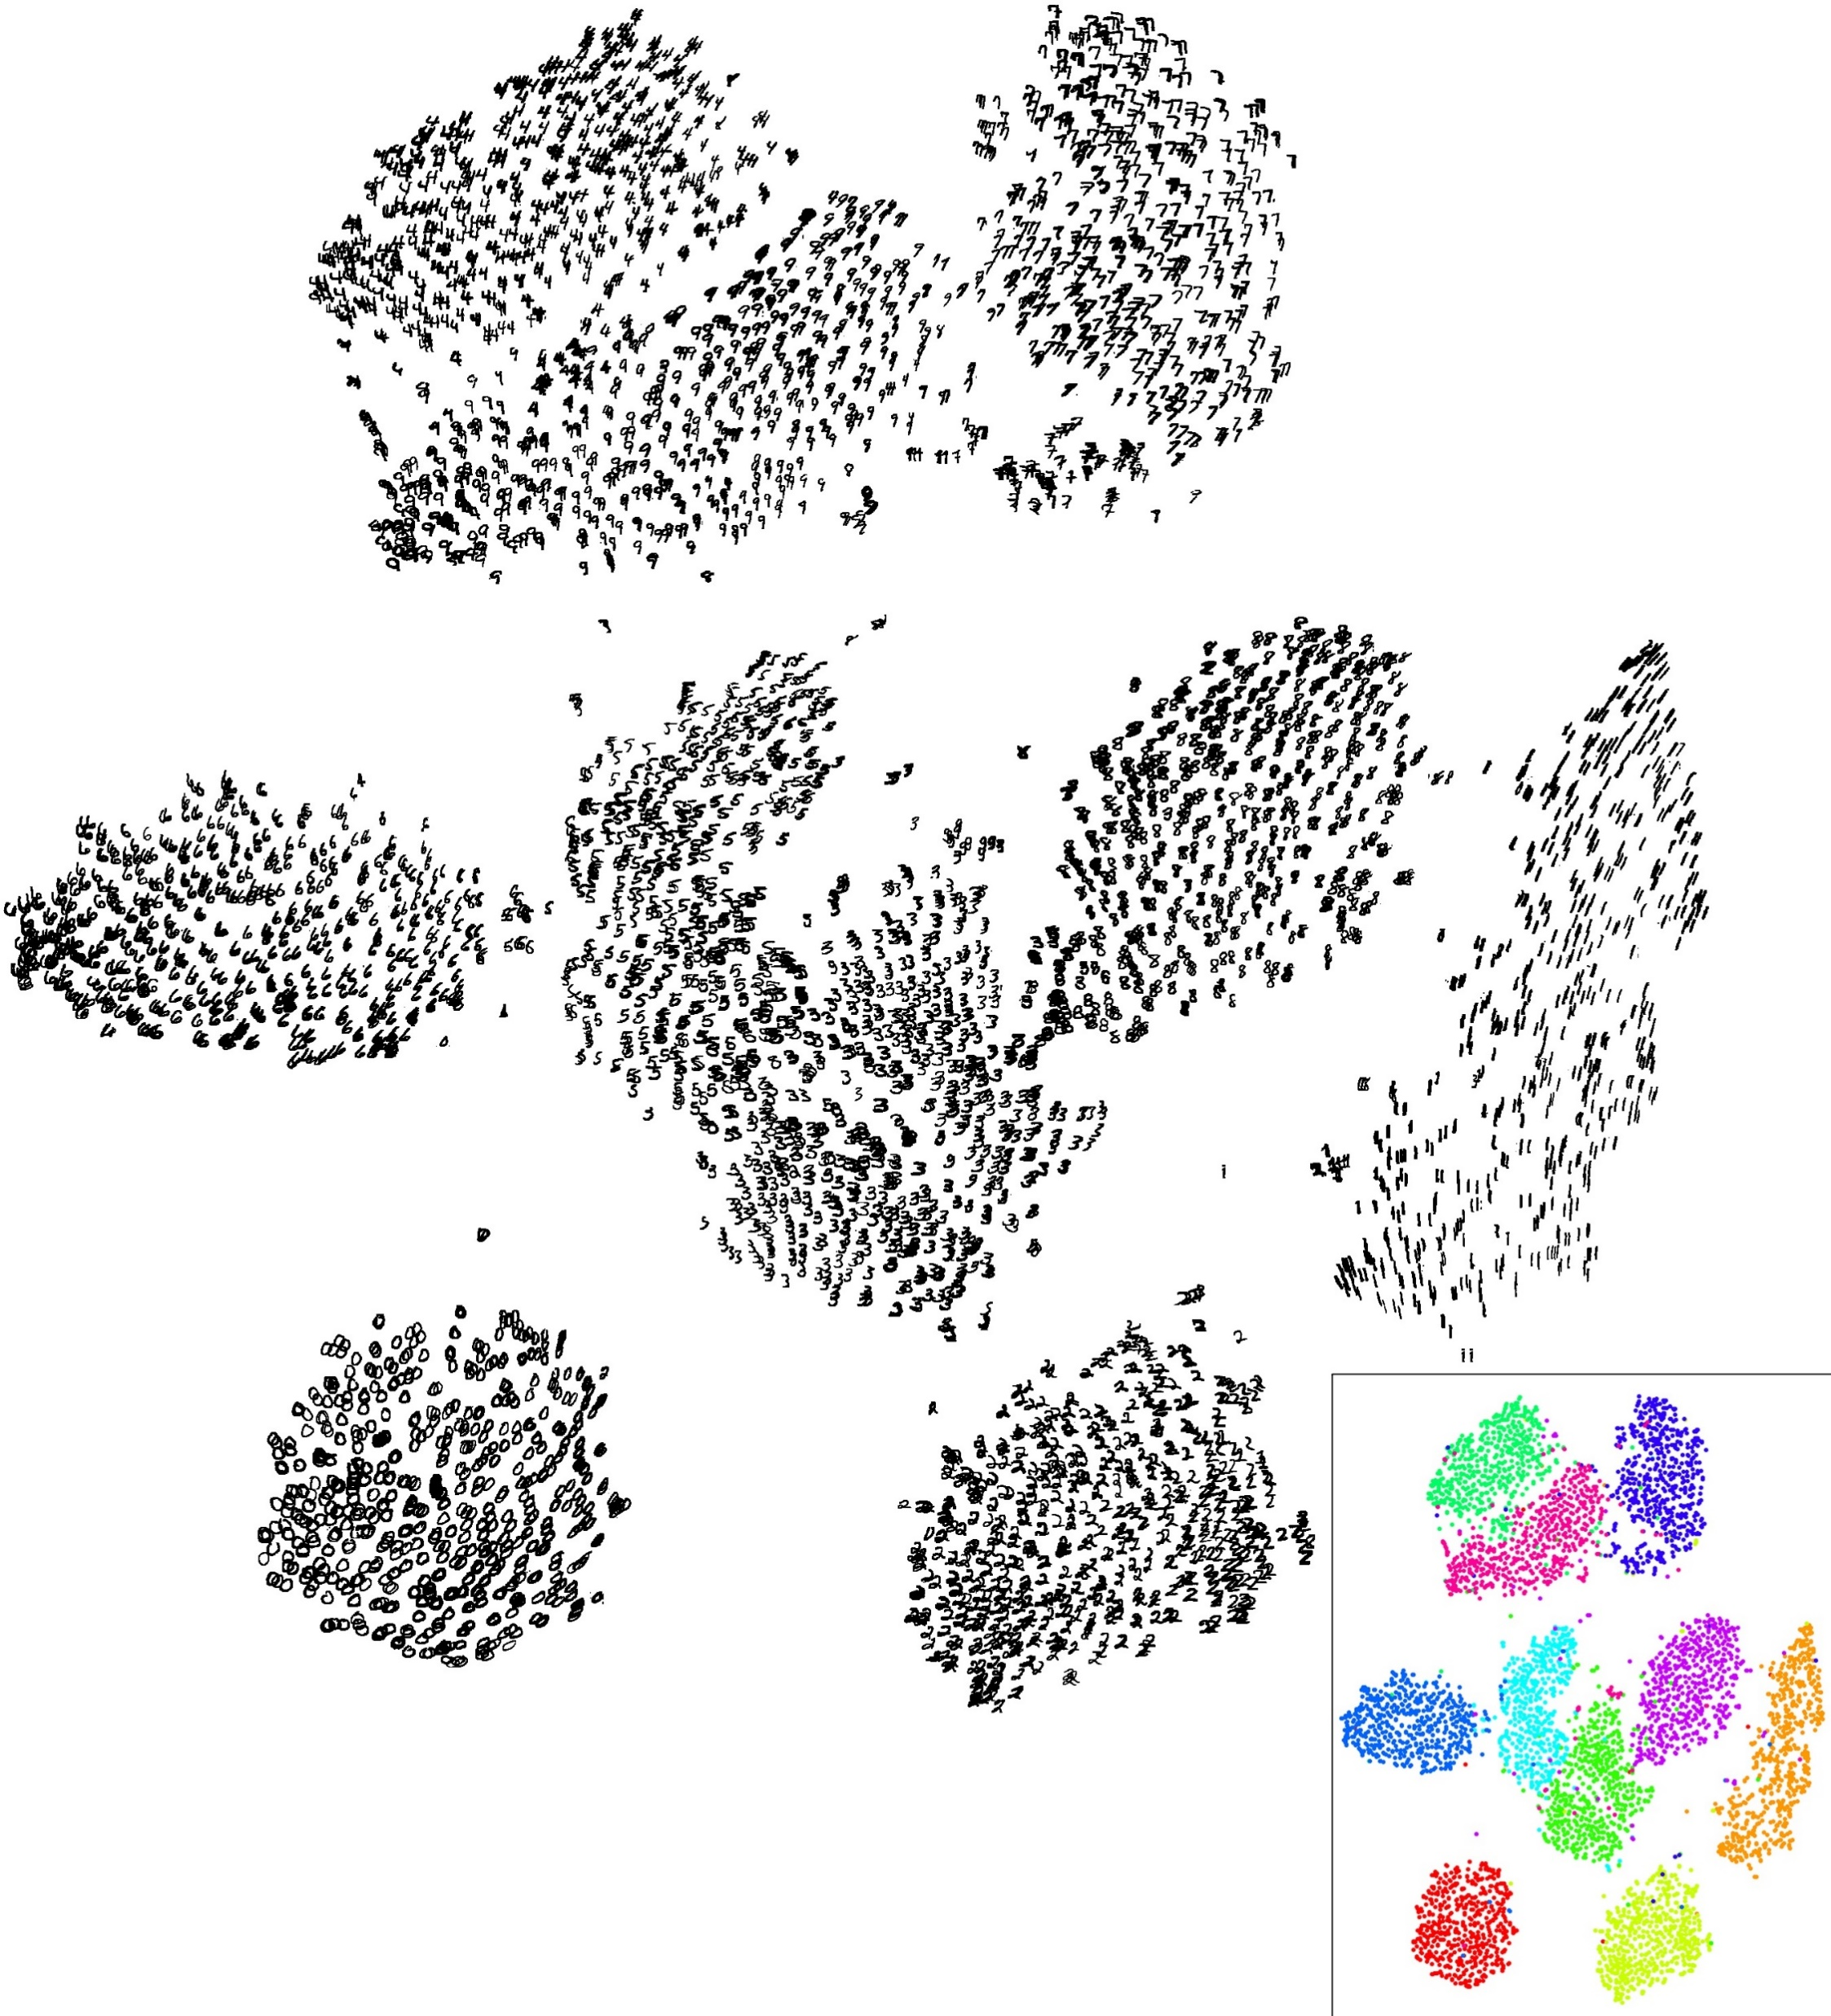
Unsupervised learning
Unsupervised learning is the machine learning task of inferring a function to describe hidden structure from "unlabelled" data.

Slide 12
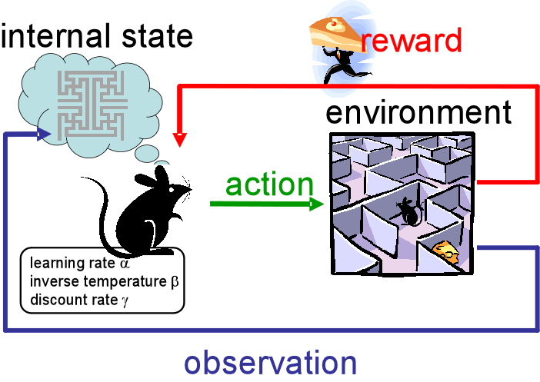
Reinforcement learning
Is an area of machine learning inspired by behaviourist psychology, concerned with how software agents ought to take actions in an environment so as to maximize some notion of cumulative reward.

Slide 13
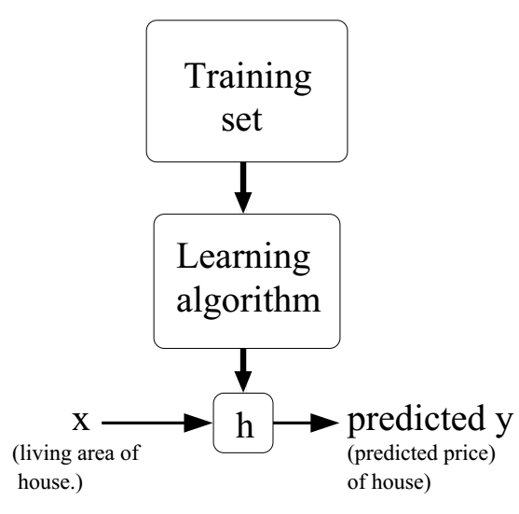

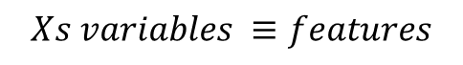
Machine learning basic terminology
$$Xs variables ≡features$$
$$θs ≡model prameter, the constant we are learning them$$
$$h_{θ}\left(x\right) model ≡hypothesis$$
$$Cost function J\left(θ\right)≡the evaluation criteria$$

Slide 14
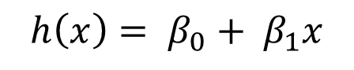
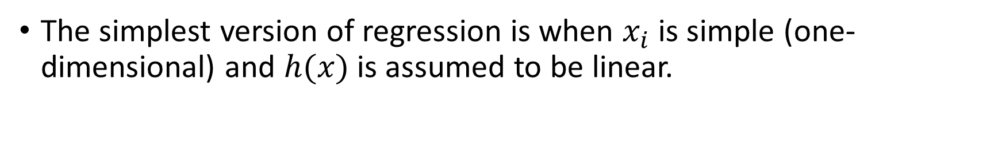
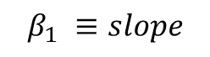
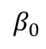
Linear Regression
The simplest version of regression is when $x_{i}$ is simple (one-dimensional) and $h(x)$is assumed to be linear.
$$h\left(x\right)= β_{0}+ β_{1}x$$
$$β_{1} ≡slope$$
$$β_{0}$$

Slide 15
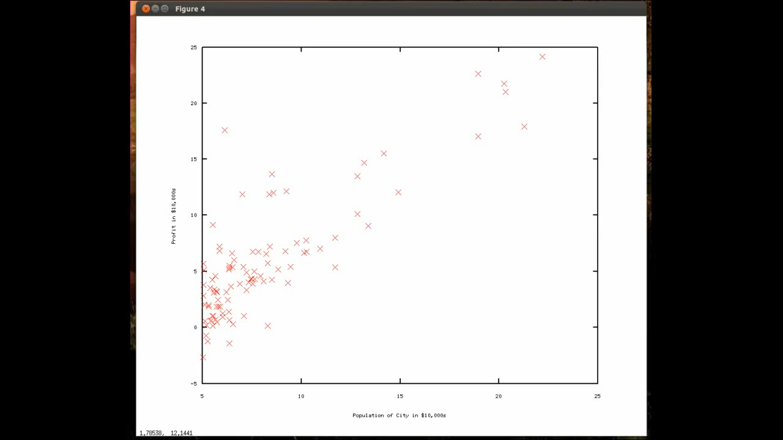

Slide 16

Learning paradigms
Maximum likelihood estimation.
Maximum a posterior estimation.
Bayesian Realm.

Slide 17
MLE
Maximum likelihood estimation is a method that determines values for the parameters of a model.
The parameter values are found such that they maximise the likelihood that the process described by the model produced the data that were actually observed.

Slide 18

likelihood function
The likelihood function is not a probability density function.
It is an important component of both frequentist and Bayesian analyses
It measures the support provided by the data for each possible value of the parameter.
Notes:
If we compare the likelihood function at two parameter points and find that L(θ1|x) > L(θ2|x) then the sample we actually observed is more likely to have occurred if θ = θ1 than if θ = θ2. This can be interpreted as θ1 is a more plausible value for θ than θ2.

Slide 19
Likelihood Principle
If x and y are two sample points such that L(θ|x) ∝ L(θ|y) ∀ θ then the conclusions drawn from x and y should be identical.
Thus the likelihood principle implies that likelihood function can be used to compare the plausibility of various parameter values.

Slide 20
overfitting & underfitting

Slide 21

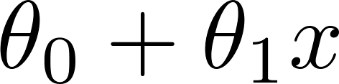
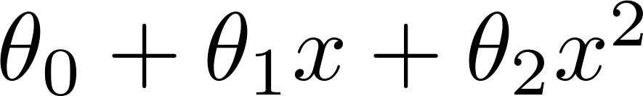
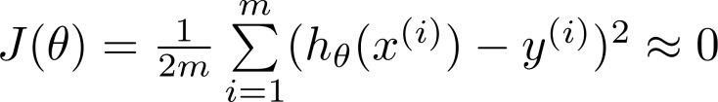
The problem of overfitting & underfitting
Price
Price
Price
Size
Size
Size
Overfitting: If we have too many features, the learned hypothesis may fit the training set very well ( ), but fail to generalize to new examples (predict prices on new examples).

Slide 22
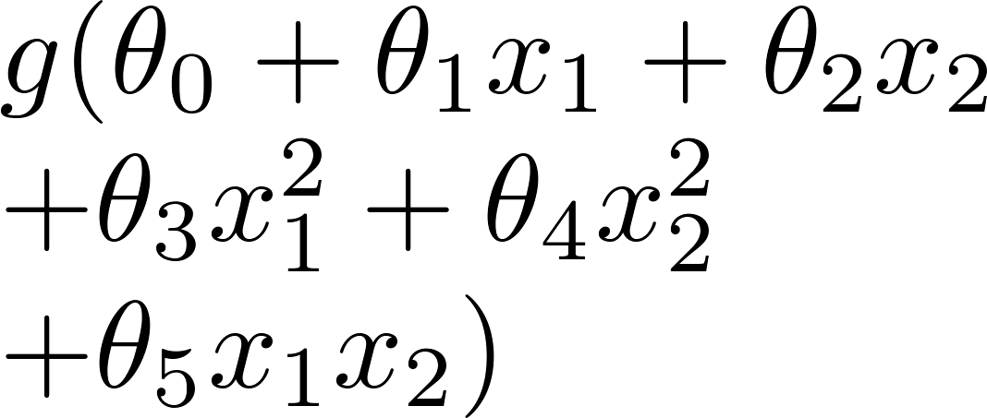
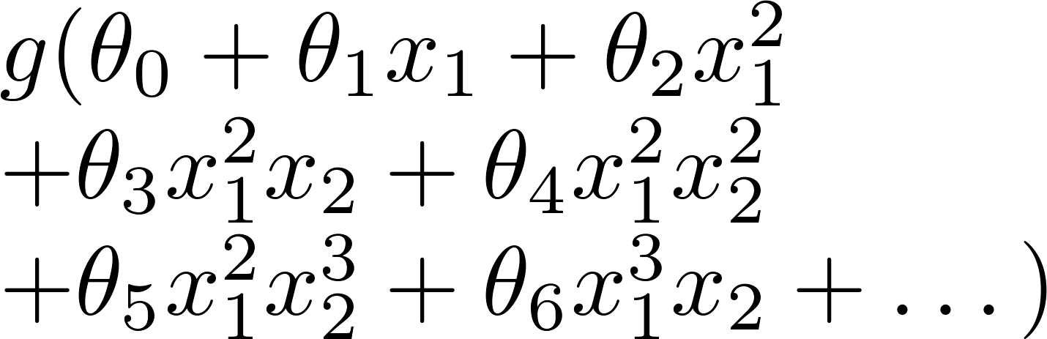
Logistic regression
x₂
x₂
x₂
x₁
x₁
x₁
( = sigmoid function)

Slide 23

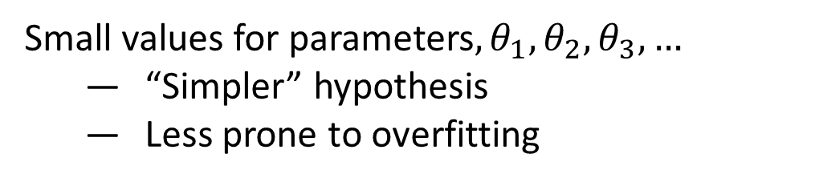
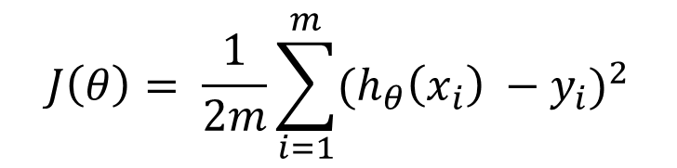
Regularization
this technique discourages learning a more complex or flexible model, so as to avoid the risk of overfitting.
Small values for parameters$,θ_{1},θ_{2},θ_{3},…$
“Simpler” hypothesis
Less prone to overfitting
By forcing the optimization to minimize over the parameters
$$J\left(θ\right)= \frac{1}{2m}\sum_{i=1}^{m}{{(h_{θ}\left(x_{i}\right) −y_{i})}^{2}}$$
Notes:
Regularization term keeps the weights small making the model simpler and avoiding overfitting.
Draw the L2 regularizer with the cost function with $λ$as regularization parameter.
We don’t regularize $θ_{0}$

Slide 24

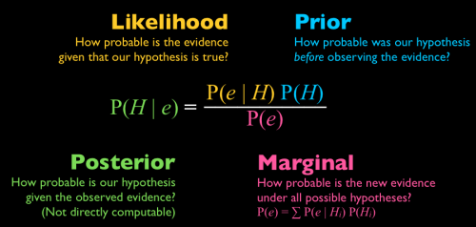
M
A
P
a
posteriori
estimation
Maximum
Prior
The parameter values are found such that they maximise that the process described by the model produced the data that were actually observed.
the posterior

Slide 25

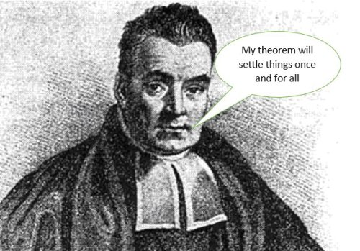
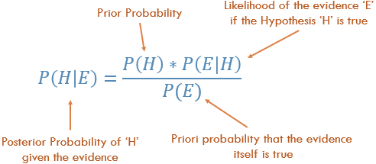
Welcome to the Bayesian Realm

Slide 26
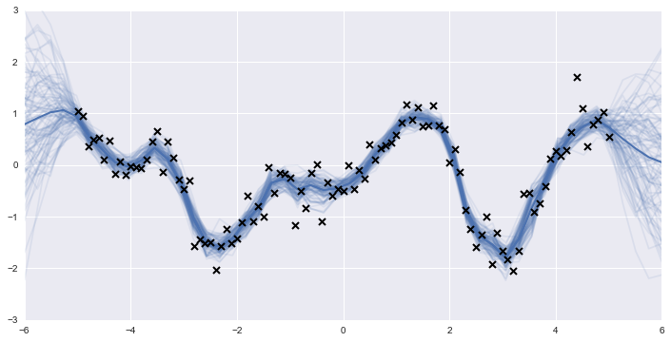

Take a sample
Distribution over parameters

Slide 27

Distribution over parameters value
Fixed parameters value

Slide 28


